Slide 1


15 Edition
Understanding Computers
Today and Tomorrow
Comprehensive
Chapter 1
Introduction to the
World of Computers
th
Deborah Morley
Charles S. Parker
Copyright 2015 Cengage Learning

Slide 2


Computers in Your Life • Why learn about computers?
– Pervasive computing
• Also known as ubiquitous computing • Computers have become an integral
part of our lives
– Basic computer literacy
• Understanding what a computer is and how it works
Understanding Computers: Today and Tomorrow, 15th Edition
5

Slide 3
Computers in Your Life
• Before 1980
– Computers were large and expensive
– Very few people had access to them
– Computers were mostly used for high-volume processing tasks
• Microcomputers in the early 1980s
– Inexpensive personal computers
– Computer use increased dramatically
Understanding Computers: Today and Tomorrow, 15th Edition
6

Slide 4
Computers in Your Life
• Today
– Nearly 90% of US households include a computer, and most use computers at work
– Electronic devices are converging into single units with multiple capabilities
• Check e-mail on living room
television
• View Internet content on mobile
devices
– Computer literacy is an essential skill for everyone Understanding Computers: Today and Tomorrow, 15th Edition
7

Slide 5
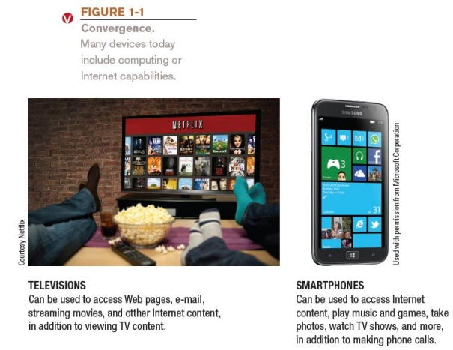
Computers in Your Life
Understanding Computers: Today and Tomorrow, 15th Edition
8

Slide 6
Computers in the Home • Computers used for a variety of tasks:
– Looking up information and news
– Exchanging e-mail
– Shopping and paying bills
– Watching TV and videos
– Downloading music and movies
– Organizing digital photographs
– Playing games
– Making vacation plans
Understanding Computers: Today and Tomorrow, 15th Edition
9

Slide 7
Computers in the Home
• Used for reference, productivity, and entertainment
• Wireless networking
– Computers can be used in nearly any location
• Smart appliances
– Traditional appliances with built-in computer or communication technology
• Smart homes
– Household tasks are monitored and controlled by a main computer in the house
Understanding Computers: Today and Tomorrow, 15th Edition
10

Slide 8
Computers in Education
• Youth today: the computing generation
• Computer labs and classrooms
– Most students today have access to computers at school – Some schools integrate e-books into the curriculum
• Wireless hotspots
– Colleges and universities are even more integrated
– Some have computer requirements for enrollment
• Supplied or Bring Your Own Device (BYOD)
• Distance learning
– Students participate from locations other than the traditional classroom setting using computers and Internet access
Understanding Computers: Today and Tomorrow, 15th Edition
11

Slide 9
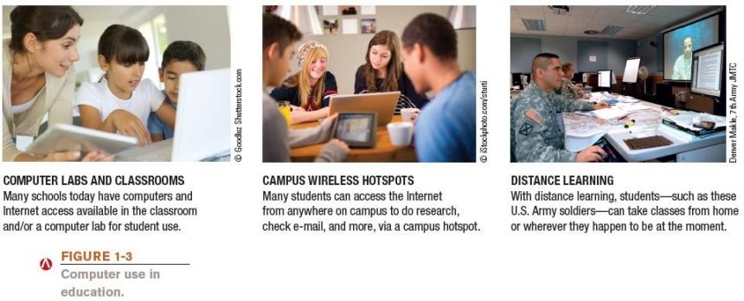
Computers in Education
Understanding Computers: Today and Tomorrow, 15th Edition
12

Slide 10
Computers on the Job
• Computers have become a universal on-the-job tool for decision-making, productivity, and communication
– By all types of employees
– For access control and other security measures
– For service professional use
– Extensively by the military
– Requires continually refreshing computer skills
– Common uses:
– Decision making, productivity, off-site communications, and authentication
Understanding Computers: Today and Tomorrow, 15th Edition
13

Slide 11
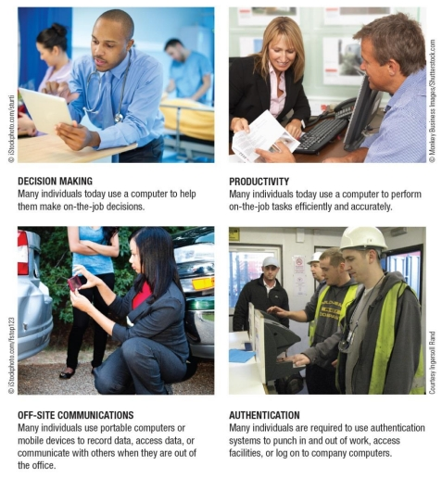

Computers on the Job
Understanding Computers: Today and Tomorrow, 15th Edition
14

Slide 12
Computers on the Go
• Computers are encountered in nearly every aspect of daily life – Consumer kiosks
– ATM transactions
– POS systems at retail stores
– Self-checkout systems
– Consumer authentication systems
– Portable computers or mobile devices
– GPS systems
Understanding Computers: Today and Tomorrow, 15th Edition
15

Slide 13
What Is a Computer and What Does It Do?
• Computer
– A programmable, electronic device that accepts data,
performs operations on that data, and stores the data
– Follows instructions, called programs, which determine the tasks the computer will perform
• Basic Operations
– Input: Entering data into the computer
– Processing: Performing operations on the data
– Output: Presenting the results
– Storage: Saving data, programs, or output for future use – Communications: Sending or receiving data
Understanding Computers: Today and Tomorrow, 15th Edition
17

Slide 14
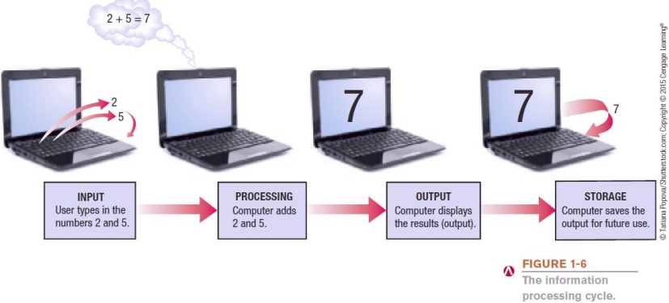
What Is a Computer and What Does It Do?
Understanding Computers: Today and Tomorrow, 15th Edition
18

Slide 15
Data vs. Information
• Data
– Raw, unorganized facts
– Can be in the form of text, graphics, audio, or video • Information
– Data that has been processed into a meaningful form • Information Processing
– Converting data into information
Understanding Computers: Today and Tomorrow, 15th Edition
19

Slide 16
Computers Then and Now
• The computer as we know it is a fairly recent invention
• The history of computers is often referred to in terms of generations
• Each new generation is characterized by a major technological development
• Precomputers and early computers (before approx. 1946)
– Abacus, slide rule, mechanical calculator
– Punch Card Tabulating Machine and Sorter
Understanding Computers: Today and Tomorrow, 15th Edition
20

Slide 17
Computers Then and Now
• First-generation computers (1946-1957)
– Enormous and powered by vacuum tubes
– Used a great deal of electricity and generated a lot of heat – ENIAC and UNIVAC
• Second-generation computers (1958-1963)
– Used transistors
– Computers were smaller, more powerful, cheaper, more energy-efficient, and more reliable
– Punch cards and magnetic tape were used to input and store data
Understanding Computers: Today and Tomorrow, 15th Edition
21

Slide 18
Computers Then and Now • Fifth-generation (now and the future)
– Infancy stage
– May be based on artificial intelligence (AI) – Will likely use voice and touch input
– May be based on optical computers and utilize nanotechnology
Understanding Computers: Today and Tomorrow, 15th Edition
22

Slide 19
Computer Users and Professionals • Computer Users (end users)
– People who use a computer to obtain information • Computer professionals include:
– Programmers
• Write programs computers use
– Systems analysts
• Design computer systems
– Computer operations personnel
• Manage day-to-day computer operations
– Security specialists
• Secure computers and networks against hackers
Understanding Computers: Today and Tomorrow, 15th Edition
32

Slide 20
Computers To Fit Every Need • Six basic categories of computers:
– Embedded computers
– Mobile devices
– Personal computers
– Servers
– Mainframe computers
– Supercomputers
Understanding Computers: Today and Tomorrow, 15th Edition
34

Slide 21
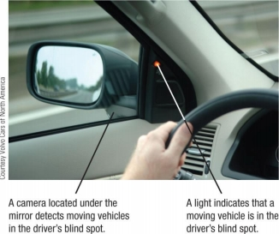
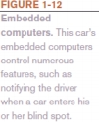
Embedded Computers
• Embedded Computers
– Embedded into a product and designed to perform specific tasks or functions for that product
– Cannot be used as general-purpose computers
– Often embedded into:
• Household appliances
• Thermostats
• Sewing machines
• Treadmills
• Answering machines
• Cars
Understanding Computers: Today and Tomorrow, 15th Edition
35

Slide 22
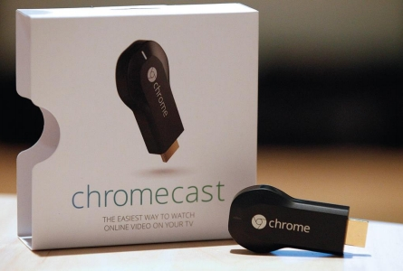
Trend Box
Tiny PCs
– Can look like a USB flash drive or small circuit board – Typically connect your TV to the Internet to display Web
content
– Some are full computers
Understanding Computers: Today and Tomorrow, 15th Edition
36

Slide 23
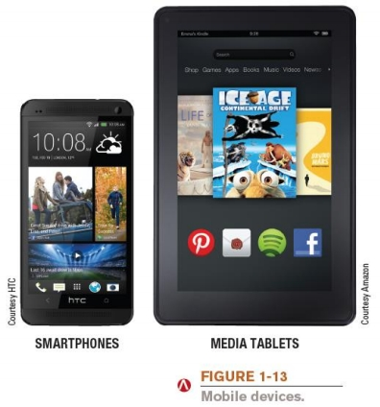
Mobile Devices
• Mobile Device
– A very small device with some type of built-in computing or Internet capability
– Typically has a small screen
and keyboard
– Examples:
• Smartphones
• Handheld gaming devices
• Portable digital media players
• Media tablets
Understanding Computers: Today and Tomorrow, 15th Edition
37

Slide 24

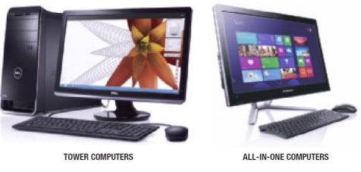
Personal Computers (PCs)
• Personal Computer (PC)
– Small computer designed to be used by one person at a time
– Also called a microcomputer
– Available in different sizes and shapes
• Desktop Computers
– On or next to a desk
– Tower case, desktop case,
or all-in-one
– PC or Macintosh
– Not portable
Understanding Computers: Today and Tomorrow, 15th Edition
38

Slide 25
Portable Computers
• Portable Computers
– Designed to be carried around easily
– Fully functional computers
– Notebook (laptop) computers
• Typically use a clamshell design
– Tablet computers
• Usually use a digital pen/stylus or touch screen
• No physical keyboard; can use on-screen or attached keyboard
– Hybrid notebook-tablet computers
– Netbooks
• Smaller and have more limited features than conventional notebooks
Understanding Computers: Today and Tomorrow, 15th Edition
39

Slide 26
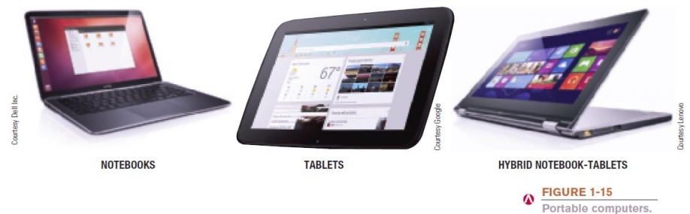
Portable Computers
Understanding Computers: Today and Tomorrow, 15th Edition
40

Slide 27
Thin Client and Internet Appliances
• Thin Client
– Designed to utilize a network for much of its processing – Lower cost, increased security and easier maintenance – Limited or no local storage
– Not able to function as a computer if network is down • Internet Appliance
– Specialized network computer designed for Internet access – Some use apps to deliver news, sports scores, weather,
music, and other Web-based information
Understanding Computers: Today and Tomorrow, 15th Edition
41

Slide 28
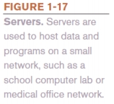
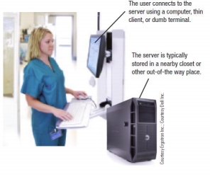
Servers
• Server
– A medium-sized computer used to host programs and data for a small network
– Sometimes referred to as a minicomputer
– Users connect via a network with a
computer, thin client, or dumb terminal
– Virtualization
• Creating virtual rather than
actual environments (often
used to share a server
for increased efficiency)
Understanding Computers: Today and Tomorrow, 15th Edition
43

Slide 29
Mainframe Computers
• Mainframe Computer
– Powerful computer used by many large organizations to manage large amounts of centralized data
– Standard choice for hospitals, universities, large businesses, banks, government offices
– Located in climate-controlled data centers and connected to the rest of the company computers via a network
– Larger, more expensive, and more powerful than servers – Usually operate 24 hours a day
– Also called high-end servers or enterprise-class servers Understanding Computers: Today and Tomorrow, 15th Edition
44

Slide 30
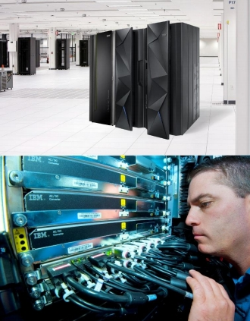
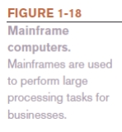
Mainframe Computers
Understanding Computers: Today and Tomorrow, 15th Edition
45

Slide 31
Supercomputers
• Supercomputer
– Fastest, most expensive, most powerful type of computer – Generally run one program at a time, as fast as possible – Can cost several million dollars each
– Tend to be very large and contain a large number of CPUs – Titan is one of the fastest computers in the world
Understanding Computers: Today and Tomorrow, 15th Edition
46

Slide 32
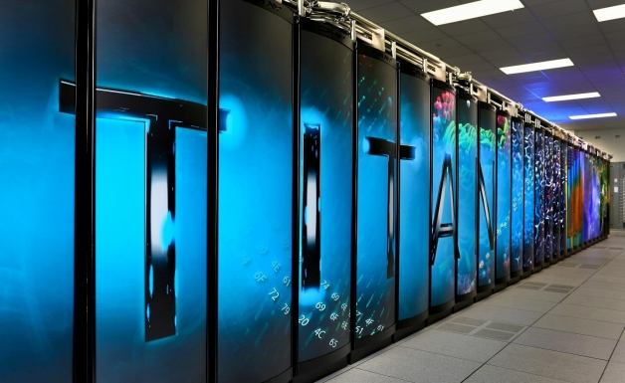
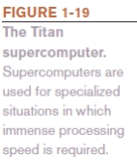
Supercomputers
Understanding Computers: Today and Tomorrow, 15th Edition
47

Slide 33
Quick Quiz
1. A tablet PC is an example of a(n) _____________.
a. Desktop computer
b. Portable PC
c. Internet appliance
2. True or False: The terms mainframe computer and supercomputer are interchangeable; both refer to the largest, most powerful computers.
3. A smartphone is an example of a(n) _____________. Answers:
1) b; 2) False; 3) mobile device
Understanding Computers: Today and Tomorrow, 15th Edition
48

